Slide 1
Security Seals
Self-sealing Closures
Emerging Trends

Slide 2
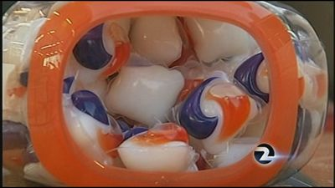

Security Seals
If it looks like candy it probably is.

Slide 3
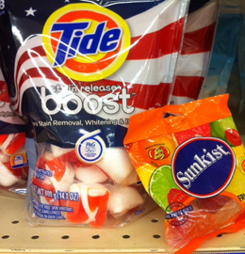
Candy versus Tabs

Slide 4
History
Development in dispensing detergent from powder to TABs created an unforeseen problem.
Higher risk because of the concentration level.

Slide 5
News bulletins
Doctors are warning about the dangers of children ingesting laundry and dishwater detergent liquitabs.
Calling for better safety warnings and childproof packaging on these products following a number of incidents where toddlers have accidentally swallowed liquitabs.
Five cases which occurred over 18 months are described in a new study from a hospital in Glasgow, with the youngest child involved being 10 months old.

Slide 6
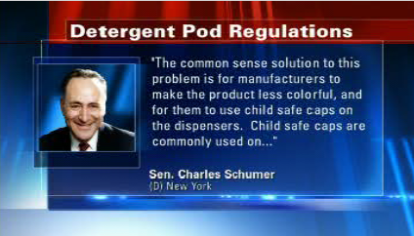
High visibility

Slide 7
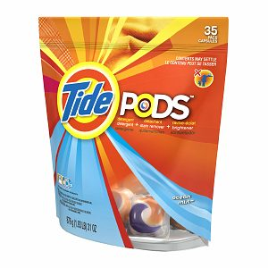
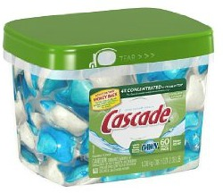

Slide 8
Child resistant standard
ISO 8317 equivalent to DIN EN ISO 8317
Test with up to 200 infants aged 42 to 51 months, the children must not be able to open the packaging, which is filled with an innocuous substitute, while a group of people aged 50 to 70 must be able to open the packaging without difficulty.

Slide 9
Child resistant zipper
No approved products today for flexible packages.
Several concepts under development.
One is being tested by third party lab.

Slide 10
Self-sealing Closure
Easy to close, no alignment needed
Velcro concept – Hook and loop
Closing on itself

Slide 11



Profiles
Hook and Loop
Plastic Hooks

Slide 12
Wide Mouth opening
Full opening on gusseted bags

Slide 13
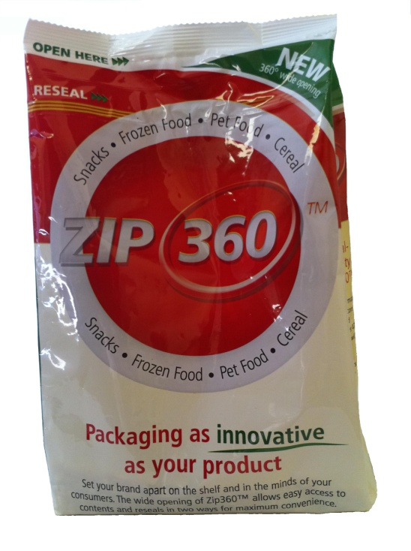
Wide Mouth opening

Slide 14
Emerging trends
Rightsizing packaging
    Smaller clips
Sustainable package
  Pillow bags and SUP – Less film
Store brand is driving down cost
  Wal-Mart (Great Value), Target (Archer Farms),
Extra features
  Sound
  Tactile

