Slide 1
- DRAFT -
Vision 2050
Generic Presentation
Short Version
March 2010

Slide 2
Summary
Overview of the Vision 2050 project
Part 1: Business-as-usual outlook to 2050
Part 2: The Vision for 2050
Part 3: The pathway to 2050
Part 4: Business opportunities
Conclusion: Urgent action is needed

Slide 3
About Vision 2050
The vision concept and the 2050 timeframe provide a clear and feasible goal for…
  Identifying the gap between today and 2050
  Developing a pathway and areas of action
  Clarifying the business perspective
  Quantifying market potential
  Agreeing on action points and next steps
Notes:
Vision 2050 is a business response to the challenges the world faces. It is a contribution that is intended to help shape the sustainability agenda, to catalyze action and to provide relevant stakeholders with a platform to bring about change.
In this project we wanted to be more disciplined, clearer and concrete in what we wanted to achieve and what we had to do. This project isn’t about saving the world – it is about helping business understand the strategic impacts of the challenges we are facing. The 2050 timeframe gave us a goal that was far way enough to act, but close enough to be relevant while the vision methodology enabled us to identify one future scenario that helped us to:
Identify the gap between today and that future.
Develop pathways maps that could take us there,
Better understand the business perspective,
Highlight and quantify market potential of the opportunities,
Agree on action points and next steps
And above all we are showing that sustainability is becoming a key strategic driver for business.

Slide 4













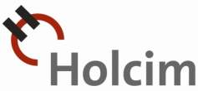














A collaborative effort involving 29 companies
Notes:
Vision 2050 is the result of a collaborative effort. The project was governed by four co-chair companies (Alcoa, PricewaterhouseCoopers, Storebrand, and Syngenta), and the content developed by 29 WBCSD member companies through working with each other, with hundreds of representatives from business, government and civil society, with regional partners and with experts. It also builds on WBCSD reports and work done by others.
The 29 companies represent a wide range of sectors (aerospace, biotechnology, building materials, chemicals, electronics, energy, forestry & paper, household & personal products, information technology services, insurance, metals, mining, motor vehicles, utilities) and are from different parts of the world (North America, Europe, Asia).

Slide 5
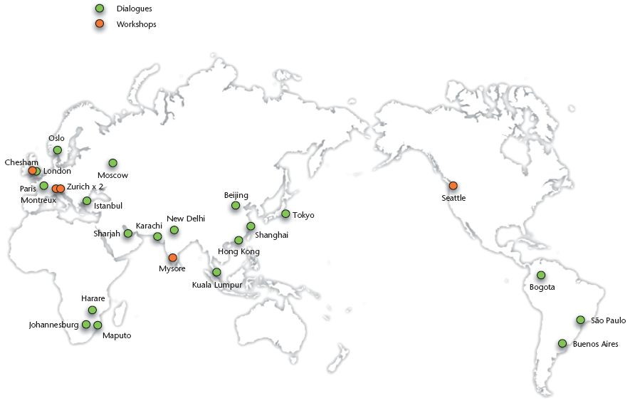
A global business dialogue
Washington DC
Notes:
Throughout the project, a number of core workshops and dialogues were conducted in major regions around the world. The aim was to ensure that the findings from Vision 2050 reflect a global perspective. The mapping here shows the regions engaged in this highly collaborative and productive effort – which was made possible through the support of the WBCSD Regional Network partners and various other stakeholder groups.

Slide 6
The different steps of the Vision 2050 project
Business-as-usual outlook to 2050
Vision 2050
Opportunities
Pathway to 2050
Notes:
The Vision 2050 project is a backcasting exercise.
We started by depicting what the world will look like in 2050 if we do not address correctly the sustainability challenge
Based on this picture, we developed a vision for 2050 of a world well on-track toward sustainability. A world in which the global population is not just living on the planet, but living well and within the limits of the planet.
A pathway was developed to connect this sustainable future with the present. The goal was to see what a real, global attempt at sustainable development – with all the radical policy and lifestyle changes this would entail – would mean for business and markets in general and for the individual participating sectors.
The good news is that there are significant opportunities within this transition – to do more with less, to create new products and services, and to provide value to both our customers and shareholders. Those companies that understand that global challenges are becoming the key strategic drivers for business and appreciate the need for firm action and new partnerships to address societies problems – are most likely to be the winners.

Slide 7
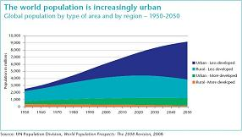
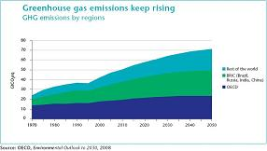
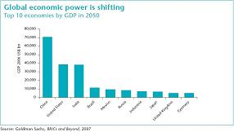
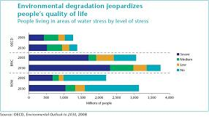
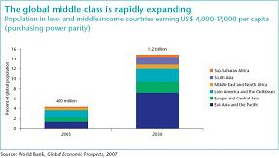
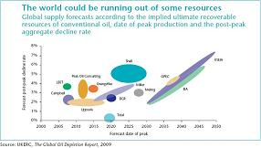
A business-as-usual outlook to 2050: Growth and degradation
Notes:
Our first step was to identify the major trends for 2050 in terms of social and economic development and their predictable impact on the environment, in order to answer this simple question: what will the world look like if we do not address the sustainability challenge correctly?
The story that we have found is one of growth in populations and consumption (in most countries) compounded by inertia stemming from inadequate governance and policy responses necessary to manage this growth. The result is degradation of the environment and societies.
Figure upper-left: Between now and 2050 the global population is expected to increase from 6.9 billion to more than 9 billion, with 98% of this growth happening in cities and in the developing and emerging world, according to UN estimates.
Figure middle-left: Most of the economic growth will happen in developing and emerging economies.
Figure down-left: Many people in the developing and emerging world will be moving up the economic ladder toward a middle class standard of living consuming many more resources per capita.
Transition: The governance and policy responses to manage this growth often happen in silos and limited by short-term, localized political pressures. Continuing to invest in polluting or energy-inefficient types of infrastructure and opting for high-footprint consumer lifestyle preferences are examples of choices that are often characterized by inertia due to short-term goals and self interest.
Figure upper-right: On the other side of the mirror, in terms of degradation, greenhouse gas emissions keep rising, especially in the developing world and in particular in BRIC countries, the nest top economies in terms of GDP.
Figure middle-right: Environmental degradation also jeopardizes people’s quality of life. An accelerating use of natural resources are continuing to affect key ecosystem services, and freshwater in particular. People living in areas of severe water stress will significantly increase.

Slide 8
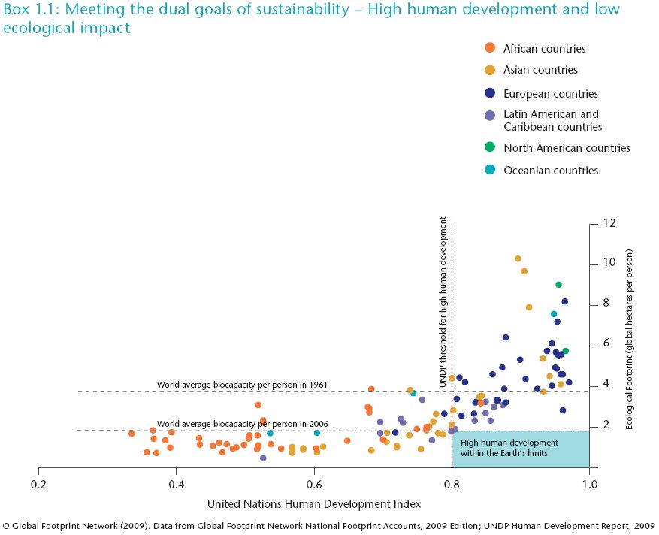
Meeting the dual goals of sustainability: High human development and low ecological impact
Notes:
This chart sums up the challenge of sustainable development: meeting human demands within the ecological limits of the planet. It is a snapshot showing how different countries perform according to the United Nations Development Programme’s (UNDP) Human Development Index (HDI) and Global Footprint Network’s Ecological Footprint. In countries to the left of the vertical line marking a score of less than 0.8 on the HDI, a high level of development, as defined by UNDP, has not been attained. Countries above the horizontal dotted line and to the right of the vertical line have achieved a high level of development but place more demand on nature than could be sustained if everyone in the world lived this way. In order to move toward a sustainable future the world will need to address all dimensions of this chart – the concepts of success and progress, the biocapacity available per person, as well as helping countries either improve their levels of development or reduce their ecological impact (several countries face both challenges).

Slide 9
The Vision: Nine billion people living well, within the limits of the planet
Vision 2050
Diversity & interdependence
A different economic reality
Multi-partner governance
Dealing with climate change
An evolved workplace & evolved employers
In markers: Innovating & deploying solutions
Notes:
The conclusion of the BAU outlook to 2050 is that the World is on an unsustainable track. Based on this statement, we developed a vision for 2050 answering the question: what the world could look like if humanity addresses the sustainability challenge? Our objective was to map out not what we think will be, nor what we fear will be, but what could be.
Given the megatrends of climate change, global population growth and urbanization, and given the best efforts of business, governments and society, Vision 2050 is a picture of the best possible outcome for the human population and the planet it lives on over the next four decades.
Our vision for 2050 can fit in one sentence: 9 billion live well, and within the limits of the planet. In 2050, the global population has begun to stabilize, mainly due to the education and economic empowerment of women and increased urbanization. More than 6 billion people, two-thirds of the population, live in cities. People have the means to meet their basic human needs, including the need for dignified lives and meaningful roles in their communities. They have enough food, clean water, sanitation, shelter, mobility, education and health to make for wellness.
Diversity and interdependence: Countries and culture remain diverse and heterogeneous, but education through secondary school and universal connectivity have made people more aware of the realities of their planet and everyone on it developing a “One World – People and Planet” ideal.
A different economic reality: Economic growth has been decoupled from ecosystem destruction and material consumption, and re-coupled with sustainable economic development and societal well-being. Society has redefined the notion of prosperity and successful lifestyles, as well as the bases of profit and loss, progress and value creation to include more long-term considerations such as environmental impacts and personal and societal well-being.
Multi-partner governance: Nations and the roles of governments continue to evolve. Much governance happens at community, city and regional levels involving a mosaic of partners. It is a complex, yet efficiently connected world.
In markets: Governance also enables and guides markets by clarifying limits and establishing frameworks that promote transparency, inclusiveness, internalized externalities, and other characteristics of sustainability.
Dealing with climate change: Society prepares for, and adapts to, climate change; this adaptation is achieved largely through joint efforts between different countries and communities. Integrated and systemic approaches are used to manage agriculture, forestry, water and urban transport, energy and communications.
An evolved workplace and evolved employers: The leading companies are those that, through their core businesses, help society manage the world’s major challenges. They have worked through the radical transformation of both internal corporate values and external market restructuring that has occurred in the four decades leading up to 2050, a transformation that many other companies have not survived but in which multitudes of new ones have been spawned.

Slide 10
The pathway to 2050 and its nine elements
Vision 2050
2050
Measures of success
Transformation Time
2040
Opportunities
2030
Turbulent Teens
2020
“Must-haves”
2010
People’s values
Human development
Economy
Agriculture
Forests
Energy & power
Buildings
Mobility
Materials
Today
Notes:
A pathway is a set of descriptions that illustrates the transition to a certain scenario, in this case Vision 2050. The pathway that we have identified is composed of nine elements that demonstrate that behavior change and social innovation are as crucial as better solutions and technological innovation.
Although distinct, the elements also show the interconnectedness of issues such as water, food and energy – relationships that must be considered in an integrated and holistic way, with tradeoffs that must be understood and addressed.
The pathway and its elements neither prescribe nor predict, but are plausible stories the companies have created by “backcasting”, working back from the vision for 2050 and identifying the changes needed to reach it.
The nine elements, or critical areas in which actions need to be taken over the next four decades are values and behaviors, human development, economy, agriculture, forests, energy and power, buildings, mobility and materials.
We have detailed our vision for 2050 in each of the nine elements with a clear measure of success for each of them. For example, for the energy and power element, our vision is that a secure and low carbon energy is widely available and used efficiently. Here, the measure of success is that CO2 emissions will have been halved.
On the way to achieve this vision, we see two timeframes: the Turbulent Teens, from 2010 to 2020 and the Transformation Time, from 2020 to 2050.
The Turbulent Teens is a period of energy and dynamism for the global vision of sustainability. It is a formative decade for the ideas and relationships that will take place in the 30 years to follow. During this period, it becomes clear that swift, radical and coordinated actions are required at many levels, by multiple partners.
As part of these Turbulent Teens, we have identified several “must-haves”, things that need to happen to achieve our vision. These must-haves are specific to each element but they all talk about innovation, policies, financing or a deeper understanding of what is going on.
In the Transformation Time, the traits formed during the first decade mature into more consistent knowledge, behavior and solutions. It is a period of growing consensus as well as wrenching change in many parts of society – climate, economic power, population – and a time for fundamental change in markets that redefines values, profits and success.

Slide 11
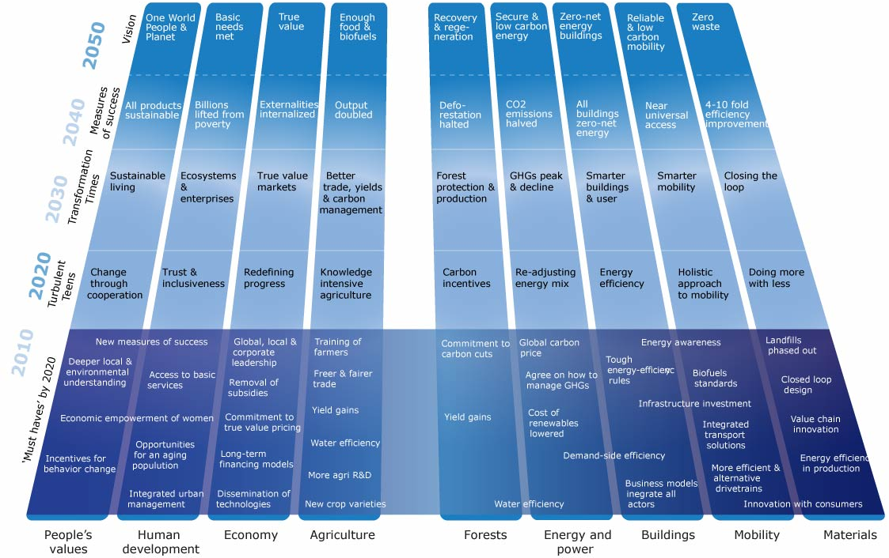
The pathway to 2050 and its nine elements
Vision 2050
Today
Notes:
A pathway is a set of descriptions that illustrates the transition to a certain scenario, in this case Vision 2050. The pathway that we have identified is composed of nine elements that demonstrate that behavior change and social innovation are as crucial as better solutions and technological innovation.
Although distinct, the elements also show the interconnectedness of issues such as water, food and energy – relationships that must be considered in an integrated and holistic way, with tradeoffs that must be understood and addressed.
The pathway and its elements neither prescribe nor predict, but are plausible stories the companies have created by “backcasting”, working back from the vision for 2050 and identifying the changes needed to reach it.
The nine elements, or critical areas in which actions need to be taken over the next four decades are values and behaviors, human development, economy, agriculture, forests, energy and power, buildings, mobility and materials.
We have detailed our vision for 2050 in each of the nine elements with a clear measure of success for each of them. For example, for the energy and power element, our vision is that a secure and low carbon energy is widely available and used efficiently. Here, the measure of success is that CO2 emissions will have been halved.
On the way to achieve this vision, we see two timeframes: the Turbulent Teens, from 2010 to 2020 and the Transformation Time, from 2020 to 2050.
The Turbulent Teens is a period of energy and dynamism for the global vision of sustainability. It is a formative decade for the ideas and relationships that will take place in the 30 years to follow. During this period, it becomes clear that swift, radical and coordinated actions are required at many levels, by multiple partners.
As part of these Turbulent Teens, we have identified several “must-haves”, things that need to happen to achieve our vision. These must-haves are specific to each element but they all talk about innovation, policies, financing or a deeper understanding of what is going on.
In the Transformation Time, the traits formed during the first decade mature into more consistent knowledge, behavior and solutions. It is a period of growing consensus as well as wrenching change in many parts of society – climate, economic power, population – and a time for fundamental change in markets that redefines values, profits and success.

Slide 12
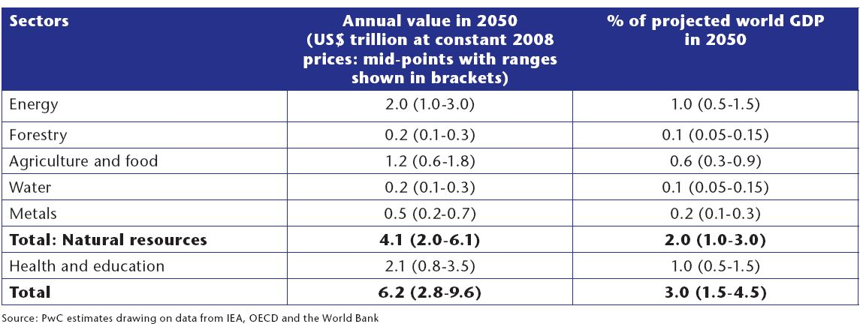
Economic estimates
Potential additional sustainability related business opportunities in key sectors in 2050
Notes:
The potential magnitude of the global business opportunities that could arise from realizing a sustainable future is considerable. PricewaterhouseCoopers (PwC) has, as part of their contribution to the Vision 2050 project, prepared an illustrative analysis of the order of magnitude of some of the global business opportunities that might arise if the vision of a sustainable future in 2050 is realized. They adopted a top-down macroeconomic approach, making use of existing bottom-up analysis by the International Energy Agency (IEA) in the climate change area. The analysis focuses on required additional investment or spending in two key areas highlighted in the Vision 2050 study: natural resources, and health and education. Other sectors were not included due to the absence of any clear basis for producing quantified estimates, but they would be expected to add further to the scale of business opportunities.
Illustrative estimates suggest that the sustainability related global business opportunities in natural resources (including energy, forestry, agriculture and food, water and metals) and health and education (in terms of social sustainability) could build up steadily to around US$ 3-10 trillion annually in 2050 at constant 2008 prices, or around 1.5-4.5% of world GDP at that time. By 2020 the figure could be around US$ 0.5–1.5 trillion per annum at constant 2008 prices (assuming a broadly linear build-up of these opportunities over time as a share of GDP).

Slide 13
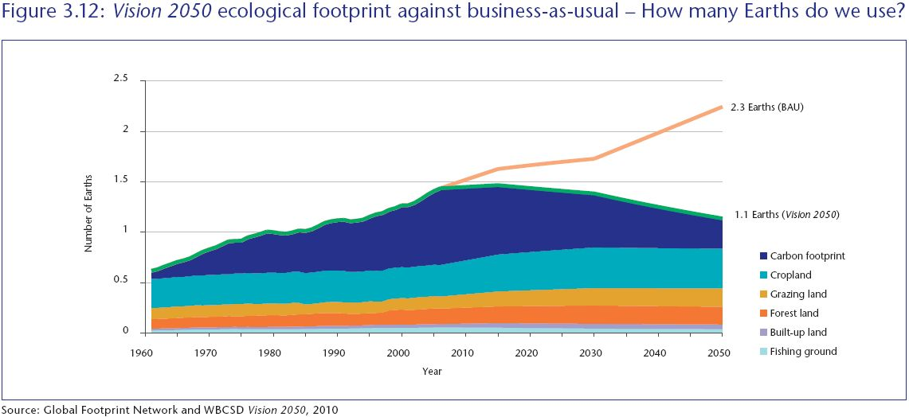
Ecological estimates
Vision 2050 ecological footprint against business-as-usual – How many Earths do we use?
Notes:
In collaboration with the Global Footprint Network, we calculated the Vision 2050 ecological footprint against business-as-usual. We found that by 2050, despite increases in population, humanity will be using the equivalent of just over one planet, based on the changes we embrace in Vision 2050, as opposed to the 2.3 planets we would be using if we continued on the business-as-usual path we are on today. The world will be in a
much better position if we maintain the course implied in the pathway and its elements, with the possibility of getting to one planet by around the end of the 2050s, early 2060s.

Slide 14
Opportunities: Business domains for the next decade
Building & transforming…
a. Cities
b. Infrastructure
c. Livelihoods & lifestyles
Helping change happen
Improving biocapacity & managing ecosystems
Notes:
To better understand the opportunities and what it takes to realize them, the project has developed a high level overview of the spaces in which opportunities exist. This opportunity map is also an important tool for strategic thinking, dialogue and collaboration. It can be used between management teams and the board, between executives and employees and as a challenge for innovation.
With the population growing by 30 % between now and 2050 and nearly 70% percent of people expected to be living in urban areas it is clear that building and maintaining cities, infrastructure and livelihoods present opportunity for investments and opportunities. Improving biocapacity and managing ecosystems will also provide rich-ground for many businesses.
It is also clear that different partnerships are needed to make these opportunities happen.
Looking at water as an example:
According to a recent McKinsey report, by 2030 global water requirements could be 40 percent above current accessible, reliable supply. India’s annual water demand in 2030 will be 1,500 cubic km against the likely availability of 744 cubic km. However, the report forecasts that India’s annual water input through rainfall will be 3,840 cubic km. In short, double the water needed will be potentially available but would have to be tapped, stored and supplied to bridge the water deficit.
Massive investments in integrated and smart water management systems will be needed to plug this gap. This will require public-private partnerships in urban development, cross-sector partnerships in solution development, demand-side efficiency and new financing mechanisms.
To help much of this change happen represents a business idea for us. An asset manager – developing financing solutions.

Slide 15
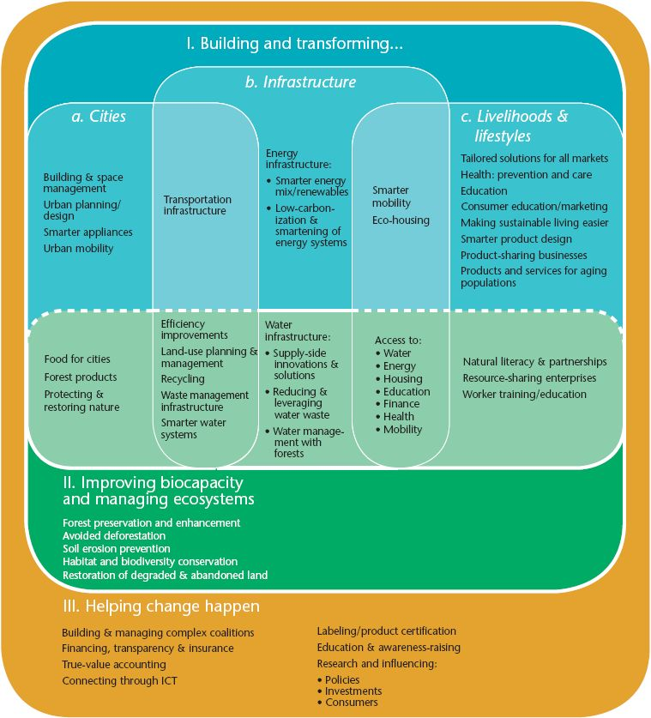
Opportunities: Business domains for the next decade
Notes:
To better understand the opportunities and what it takes to realize them, the project has developed a high level overview of the spaces in which opportunities exist. This opportunity map is also an important tool for strategic thinking, dialogue and collaboration. It can be used between management teams and the board, between executives and employees and as a challenge for innovation.
With the population growing by 30 % between now and 2050 and nearly 70% percent of people expected to be living in urban areas it is clear that building and maintaining cities, infrastructure and livelihoods present opportunity for investments and opportunities. Improving biocapacity and managing ecosystems will also provide rich-ground for many businesses.
It is also clear that different partnerships are needed to make these opportunities happen.
Looking at water as an example:
According to a recent McKinsey report, by 2030 global water requirements could be 40 percent above current accessible, reliable supply. India’s annual water demand in 2030 will be 1,500 cubic km against the likely availability of 744 cubic km. However, the report forecasts that India’s annual water input through rainfall will be 3,840 cubic km. In short, double the water needed will be potentially available but would have to be tapped, stored and supplied to bridge the water deficit.
Massive investments in integrated and smart water management systems will be needed to plug this gap. This will require public-private partnerships in urban development, cross-sector partnerships in solution development, demand-side efficiency and new financing mechanisms.
To help much of this change happen represents a business idea for us. An asset manager – developing financing solutions.

Slide 16
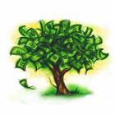
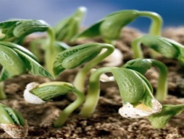
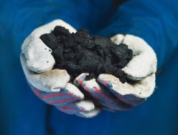
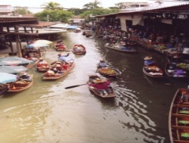
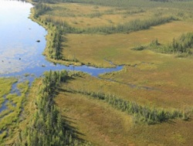

Improving biocapacity and managing ecosystems
Potential growth of some ecosystem markets (US$ billion)
FAW management
Ecosystem
payments
Technology
Bio-productivity
Distribution
FAW
management
Education
Source: Forest Trends and the Ecosystem Marketplace, PES: Market Profiles, 2008
Notes:
This is an example of the business opportunities that we have identified on the way to a sustainable world in 2050.
The potential for ecosystem markets is huge. Meeting growing levels of demand for nature’s services while limiting ecological impact points to demand for new types of payments, products, services and business models.
Managing ecosystems and biodiversity represents an opportunity for multiple sectors and regions – as well as provides a means to manage risks such as disruption in the availability of necessary inputs whether it is molecules, water or biomass. [Systemic thinking, partnerships and education will provide opportunities for different industries. Understanding the relationship and interdependence between different ecosystem services such forests, agriculture and water provision will also be important [and could represent a potential billion dollar business.]
Extra facts
Payment for ecosystem services (PES) is an emerging and rapidly changing area spread out across geographies and institutions. Information on ecosystem services markets is limited and constantly changing, but future payments for
ecosystem services markets look promising. Some estimates suggest that the payments for products from certified agricultural products, suggest that PES markets could grow from US$ 42 million in 2005 to around US$ 900 billion in 2050 (assuming an annual growth rate of 5% between 2020 and 2050).

Slide 17
Closing the gap: Reaching the vision
Carbon & resources
Halve CO2 emissions, double agricultural output, 4-10 fold increase in resource efficiency
Costs
Internalize cost of carbon, water & other ecosystem services
Consumption
Change consumption patterns to more sustainable lifestyles
Collaboration
Build complex coalitions, co-innovation
Notes:
In order to reach our vision for 2050, actions are required on many fronts – the most critical changes occur in terms of carbon and resources, costs and consumption.
We will by 2050 need to have halved CO2 emissions from 2005 levels [- this should get us to 450ppm (IEA) and give us a 40-60% probability of limiting increase in global temperature to around 2 degrees Celsius. These targets may be revised as the science and impact of climate change advance.]
But as well know it is important to remember it is about more than just carbon, so we also need to double agricultural output by 2050, increasing agricultural productivity by around 2% per year to meet rising demand for food and we need to do a lot more with a lot less to increase resource and material efficiency 4 to ten fold.
In terms of costs – the key action to help close the gap is around internalizing the costs of carbon, water and major ecosystem services – which will in turn channel actions and investments towards more resource-efficient practices.
Consumption is the third key lever that we need to pull [given the fact that more than 3 and a half billion people are likely to be considered middle class by 2030.] By enabling sustainable lifestyles through the provision of goods and services we can meet people’s needs, without bankrupting the planet.

Slide 18
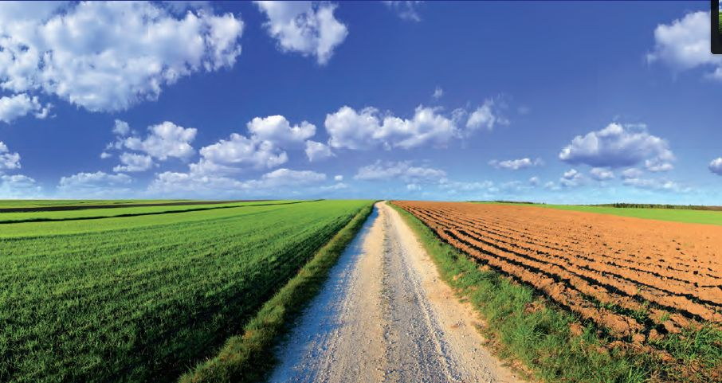
The journey begins now!
Notes:
We see the Vision 2050 project as a platform for dialogue, not a blueprint or a prescriptive plan. Its highest value may be in our narrative of the gap between Vision 2050 and a business-as-usual world, and the queries and dilemmas it raises.
The biggest unanswered questions are “How do we get there?” “What form of governance will make this changes needed happen at the speed and scale required?”
On these issues, we indicate our willingness, support and leadership, and invite all stakeholders – business, government and civil society – to join the exploration and effort.
The journey begins now!

Slide 19
Further information
More information on:
  www.wbcsd.org/web/vision2050.htm
Contacts:
  Per Sandberg,
    sandberg@wbcsd.org
    +41 22 8393101
  Kija Kummer, Assistant Manager
    kummer@wbcsd.org
    +41 22 83931XX

