Slide 1

IOPP Transport Packaging Committee
Transportation, Handling, and Testing Standards Update
12/3/14
Bryan Williams
Adeola Akinola

Slide 2
ISTA Standards Update
ANSI Accreditation Approved
  ANSI’s Executive Standards Council (ExSC) approved ISTA as an ANSI Accredited Standards Developer under its proposed operating procedures for documenting consensus on ISTA-sponsored American National Standards.
  A Test Series Group (TSG) is the consensus body responsible for voting on proposed new ISTA Test Protocols, technical revisions to existing and reaffirmation of existing ISTA Protocols and addition/termination of TSG members. The TSG must strictly observe rules regarding antitrust.

Slide 3
ISTA Standards Update
Standard 20 Rev. 2 Approved
  The second revision to Standard 20 was voted on and approved by the Thermal Council
  Standard 20 was 45 pages – Now ~25 pages
  Contains references to industry guidelines
  Aligned with FDA process validation guidance
  Data package examples (nearly 1000 pages) replaced by a 17 page book
  A more science based method to the number of thermocouples required and their location in the shipper.

Slide 4
ISTA Standards Update
Project 6-AMAZON.com-B
  General simulation test for heavy and/or bulky packaged-products shipped through Amazon’s distribution system.
  Created by Amazon.com with help from industry experts in both the packaging and transportation industries.
  Project 6-Amazon.com-B is 6-Series member performance test which are test protocols created by ISTA members to meet their particular purposes and applications.

Slide 5
ISTA Standards Update
Project 6-AMAZON.com-B
  This test is for items weighing greater than 70 lbs. (32 kg) shipped by Vendors to ecommerce distribution centers being delivered to final customer destinations via common-carrier (LTL) or parcel delivery systems.
  Combines data from previous studies of transportation environments, relevant testing protocols, visually observing the Amazon Fulfillment Center environment, and customer feedback.
  This test is currently in the Project phase (pilot stage) and will be improved upon if/where needed using feedback from industry experts and users of the test.

Slide 6
ISTA Standards Update
Project 6-AMAZON.com-B
  Users of the test will share feedback and other data from any testing conducted with package-testing@amazon.com.
  Labs capable of performing ISTA Procedure 3B can perform ISTA 6-Amazon.com-B
  Amazon.com will share this data with ISTA in an effort to improve the effectiveness of the test protocol.
  The full project is available for download via the ISTA.org website.

Slide 7

ASTM Standards Update
ASTM D10 October 2014 Meeting Recap
  100 Year Anniversary Celebration
    Alfred McKinlay Award presented to Bob Fielder (Chainalytics)
  D10.21 Task Group on D4169 Meeting
    Schedule A: Presentations on field measurements but no proposed changes (yet)
    Schedule B/C: Proposed change to average shipping density factor is withdrawn but still considering possible changes to test elements
    Schedule D/E: Requests for additional comparison testing of new Truck profile and test method. Intent to send to ballot in Spring 2015. Air and Rail profiles to be reviewed after Truck profile is approved.
    Schedule H: Balloted changes to Hot water spray test were approved.

Slide 8
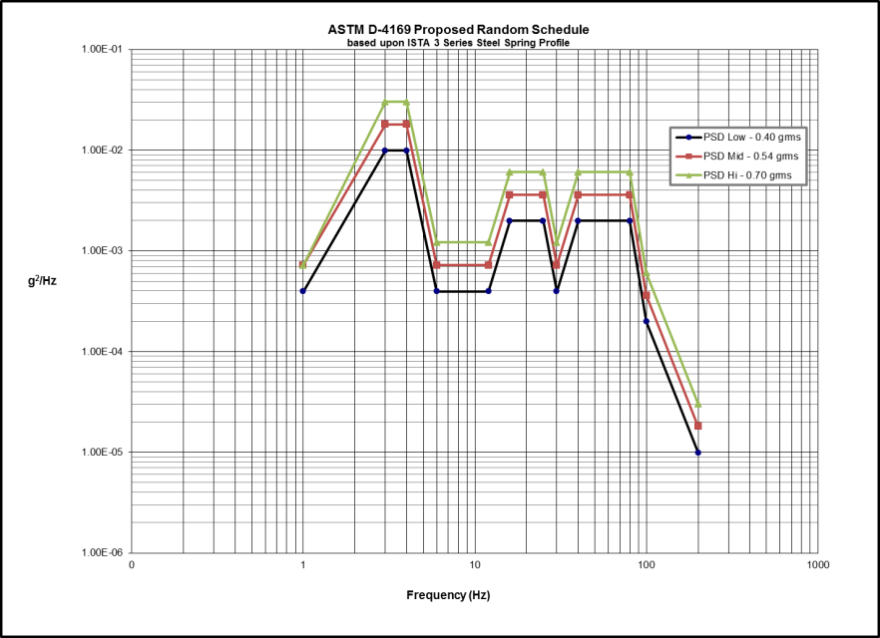
ASTM Standards Update
ASTM D4169 - Random Vibration Task Group
 | Test Sequence | Proposed Grms | Proposed Test Time
Loop | A (Low) | 0.402 | 40 minutes
 | B (Medium) | 0.542 | 15 minutes
 | C (High) | 0.701 | 5 minutes
 | Total Loop Time: |  | 60 minutes
Loop repeated three times

Slide 9
ANSI/ISO Meeting
ANSI Committee MH10 / USA TAG ISO TC122
  Meeting held during Pack Expo to discuss the ongoing work program(s).
  The untimely passing of Craig Harmon has left gaps in the work of both Groups.
  Need to identify “champions” who can fight for U.S. interests
    Need to be active, need to play defense (e.g. GMA pallets)
    Make sure U.S. list of WG experts matches ISO list
  Roles to fill include the Chairman, Secretariat, and WG roles
    MHI currently taking on Secretariat role

